Slide 1
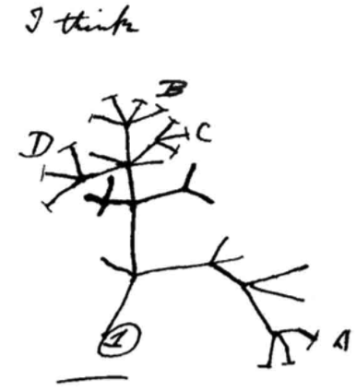

Changes to Allele Frequency in Gene Pools: The Theory of Evolution Through Natural Selection
Ch 9 Human Perspectives

Slide 2
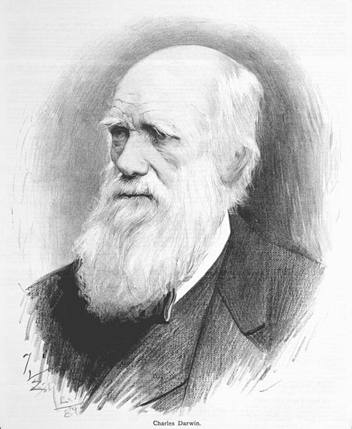
Date: | Human Biology Year 12 ATAR
Do Now Get out your equipment and textbook. Lesson Agenda 1: Do Now 2: Evolution by Natural Selection 3: Start on the Review Worksheet 4: Lesson summary and wind-up Suggested Study Complete review worksheet, then mark and correct using the answer key on Connect (compulsory). NEXT LESSON Heterozygote Advantage | Learning Aims Outline the historical development of the theory of evolution List the three observations that form the basis for evolutionary theory Describe what Darwin inferred from observations about variation, birthrate and Nature’s Balance. Give a modern definition for natural selection Summarise the 6 principles of evolution through natural selection Discuss how natural selection is Selective Directional Adaptive – influenced by environmental pressures Compare and Contrast the processes of Genetic Drift and Natural Selection Give an example of natural selection for alleles in the human population Describe changes to the Peppered Moth during the industrial revolution as evidence for evolution Define speciation List and describe the processes involved in speciation Discuss how speciation occurred for finches in the Galapagos islands
 | Key Vocabulary Evolution Natural Selection Selection Pressure Selective Advantage

Slide 3
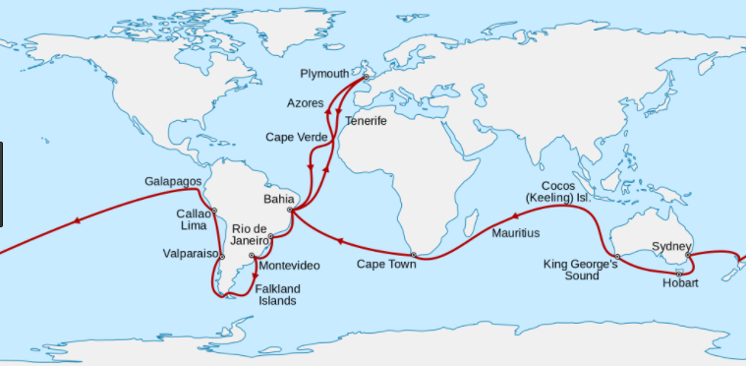
Theory of Evolution Through Natural Selection
Explanation for the huge diversity of life on Earth
Underpinned by comprehensive evidence
Initially put forward in 1858 by:
Charles Darwin
Alfred Russel Wallace
Charles Darwin:
Keen amateur naturalist
Joined a surveying expedition as a biologist
Voyaged on HMS Beagle
Galapagos Islands
New Zealand
Australia
Allowed him to observe differences and similarities between geographically separated animals.
The Voyage of the Beagle – 1831-1836
Learning Aim: Outline the historical development of the Theory of Evolution by Natural Selection

Slide 4
Theory of Evolution through Natural Selection
Built on work of other scientists:
Linnaeus – classification
Lyell – geological change
Malthus – population studies
Wallace – similar ideas to Darwin
Theory based on 3 observations made by Darwin.
Variation: members of a species vary and variations are passed on from one generation to the next.
Birth Rate: living organisms reproduce at a rate greater than their food supply and must compete for resources
Nature’s Balance: although birth rate is high, most species numbers remain at a constant level.
Learning Aim: List the three observations that helped Darwin develop evolutionary theory

Slide 5
Theory of Evolution Through Natural Selection
Based on the observations, Darwin interpreted and inferred:
Excessive birth rate and limited resources → struggle for existence
Variations mean that organisms best suited to their environment are more likely to survive → became known as “survival of the fittest”.
More organisms with favourable characteristics survive
Organisms with less favourable characteristics die before they can reproduce
Survival of Fittest possible because of variation.
Learning Aim: Describe what Darwin inferred from his observations about Variation, Birthrate and Nature’s Balance

Slide 6
Theory of Evolution through Natural Selection
Darwin did not know why variation occurs. We now know that a number of things cause this variation across a species, including:
Events during meiosis and fertilisation
Inheritance of alleles from mother and father for alternative forms of a trait or characteristic
Chance mutations
Today: natural selection can be viewed as selection of those alleles in a population that give an organism a greater survival advantage.
Favourable alleles passed to offspring.
Change in gene pool over time – adaptation of the species to the environment.
Learning Aim: Give a modern definition of natural selection

Slide 7
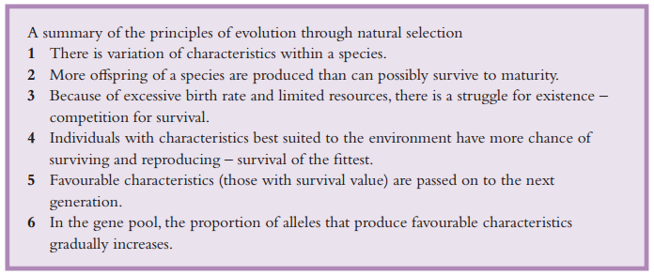
Theory of Evolution through Natural Selection
Learning Aim: Summarise the six principles of Evolution through Natural Selection

Slide 8
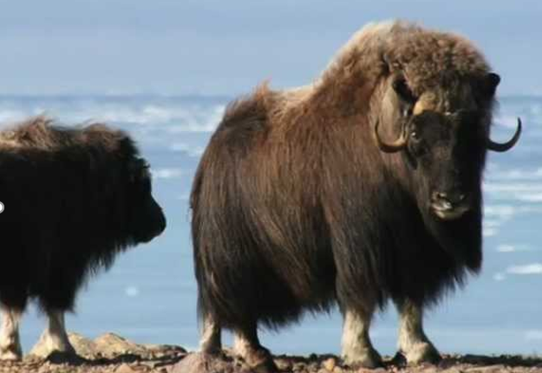
Natural Selection is Selective
Not a random process.
Allele frequency changes due to environmental factors, making some alleles more favourable for reproduction/survival in a particular environment.
Eg: An allele for longer coat length is an advantage in cold climates. Animals expressing this allele are more likely to be able to maintain body temperature to survive and/or produce more offspring, so the allele increases over time in the population
The allele for long coat in the musk ox is an advantage in the arctic climate where it lives. It means the musk ox can survive and reproduce better as it doesn’t have to expend as much energy staying warm. Because of this the allele increases in frequency – it is selected for by environmental pressure.
Learning Aim: Discuss how natural selection is SELECTIVE

Slide 9
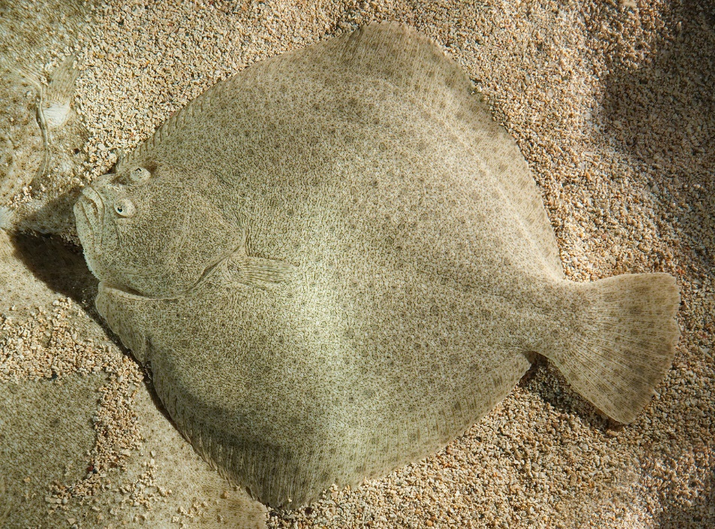
Natural Selection is Directional
Frequency of an allele in the population consistently increases over time if it is an advantage, or consistently decreases over time if it is a disadvantage.
There are several variant alleles for darkness of colour in flatfish. Light coloured alleles (and therefore scales) are an advantage in a sandy environment. Fish born with darker scales will be killed more easily by predators so those alleles will decrease in frequency over time, and the alleles for light scales will increase over time as they are an advantage. Provided the environment remains sandy, there will not be an increase in the allele for dark scales.
Learning Aim: Discuss how natural selection is DIRECTIONAL

Slide 10
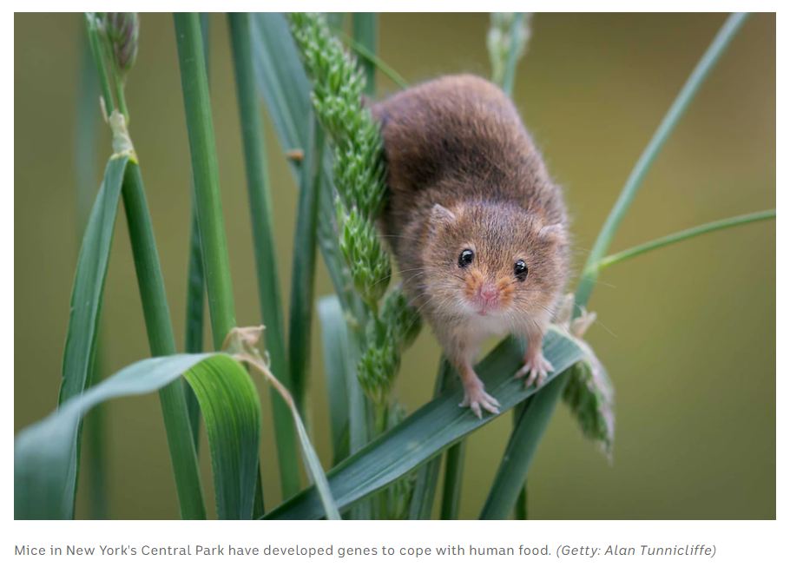
Natural Selection is Adaptive - influenced by environmental pressures
change in allele frequency helps the species adapt to its current environment.
change in allele frequency can clearly be related to environmental factors applying pressure
Mice in Central Park have a greater allele frequency for alleles that protect against obesity. These alleles are an advantage in an environment where high fat human food waste is easy to come by. High fat foods in the environment apply pressure so that the obesity protection alleles are favoured.
Learning Aim: Discuss how natural selection is ADAPTIVE – influenced by environmental pressures

Slide 11
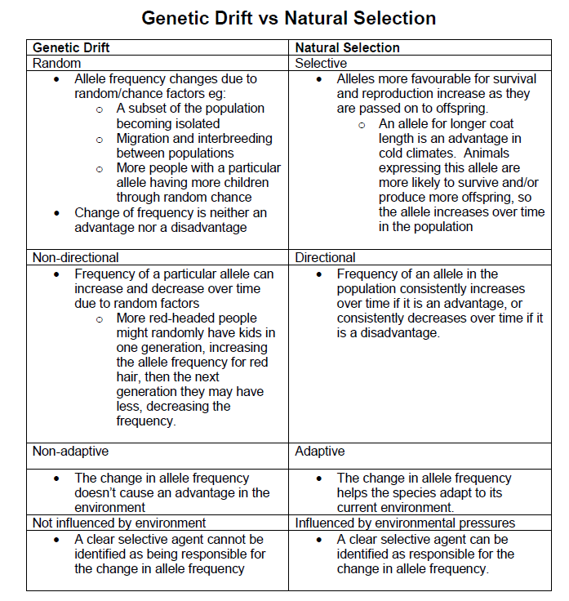
How can we tell if a change in allele frequency is the result of genetic drift or natural selection?
The key thing to look at is directionality. If the gene frequency is consistently increasing over several generations, it is likely because it provides some kind of advantage in the environmental conditions of the population. If the frequency fluctuates up and down over time, it is likely to be random drift. Note that a permanent drift is more likely where the population is small, even without a selective advantage – eg colourblindness on Pingelap.
Another thing to look at is a plausible explanation for a consistent, directional change in frequency – can you link the change to an environmental factor?
Learning Aim: Compare and Contrast the processes of Genetic Drift and natural selection

Slide 12
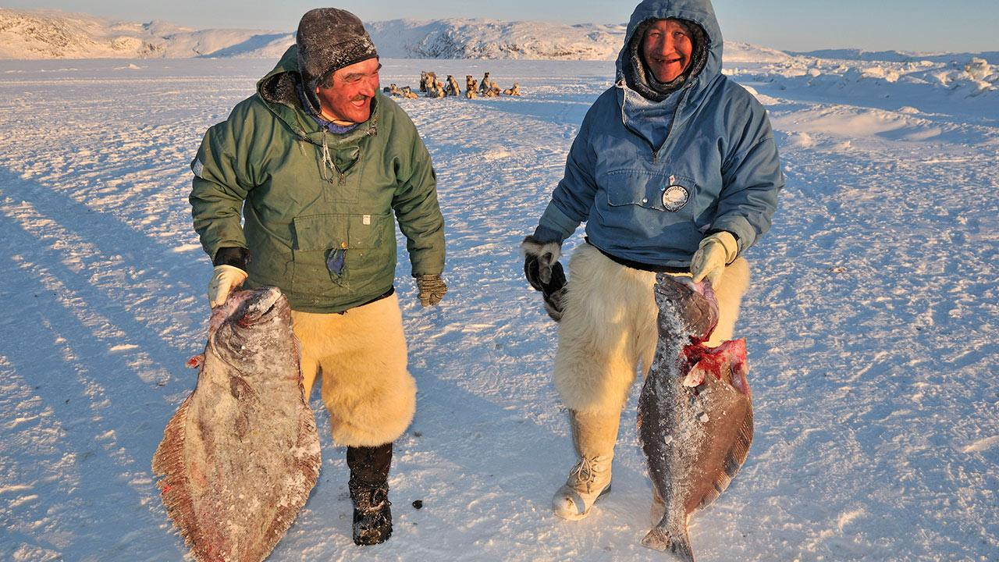
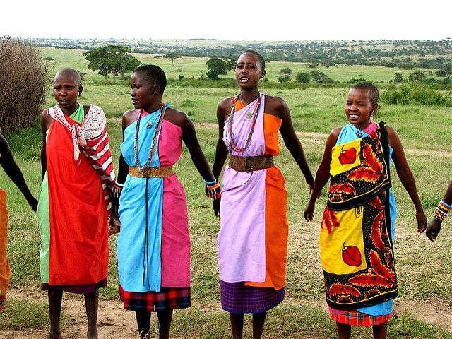
Examples of Natural Selection in Humans – Body Stature
Original gene pool would have alleles for many different body statures (tall, short, stocky, short limbed, etc)
Environment has selected for certain alleles in different environments:
Inuit: long body, short limbs – smaller surface area, less heat loss – adapted to colder conditions
Masai: long limbs – larger surface area for heat loss – adapted to warmer climate.
Learning Aim: Give an example of natural selection for traits in the human population

Slide 13
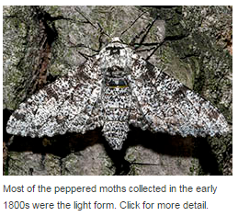
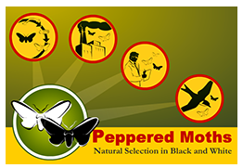
Natural Selection in Action: The Peppered Moth
Peppered Moth: Biston betularia
Wings originally light mottled – camoflaged against lichen covered tree trunks, as protection from predators.
Mutation causes dark black wings
Pre-industrial revolution, 90% of moths had pale wings
Industrial revolution: coal dust caused tree trunks to be darker.
Light coloured moths stood out – eaten by predators
Black coloured moths now camouflaged
Within 100 years, 90% of moths were black.
The coal dust darkening the tree trunks was a selective agent for the darker wing allele
Since the 1950s, pollution control has cleaned the air. Tree trunks are pale again. Moth population now light mottled again! Selection pressures have changed.
Learning Aim: Describe changes to the Peppered Moths during the industrial revolution as evidence for evolution by natural selection

Slide 14
A great website and game about the peppered moth:
https://askabiologist.asu.edu/peppered-moths-game/play.html
Learning Aim: Describe changes to the Peppered Moths during the industrial revolution as evidence for evolution by natural selection

Slide 15
From the Peppered Moth we can see:
1: There is variation of characteristics within a species – moths carry alleles for light or dark wing colouration
2: More offspring are produced than can survive to maturity – moths are killed by birds, among other things.
3: There is a struggle for existence – moths survival is not guaranteed – a bird might eat them!
4: Individuals with characteristics best suited to the environment have more chance of surviving and reproducing – white moths have more chance of surviving in a birch forest with pale tree trunks.
5: Characteristics with survival value are passed down the to the next generation – the white moths pass the allele for white wing colour on to their offspring at a greater rate than dark moths, because more white moths survive in the pale tree trunk environment.
6: In the gene pool, the proportion of alleles that produce favourable characteristics gradually increases- the allele frequency for white wing colour increases in the pale birch forest.
Natural Selection is Selective- the allele for pale wing colour provides an advantage in the pale trunk birch forest.
Natural Selection is Directional – in the pale trunk forest, the frequency of pale wing colour alleles steadily increases in the direction of advantage. Once the trunk colour changes, the frequency of dark wing alleles rises, again in the direction of the advantage.
Natural Selection is Adaptive and Influenced by Environmental Pressure – tree trunk colour causes environmental pressure that drives adaptation of wing colour – as better camouflaged moths avoid predators better.
Learning Aim: Describe changes to the Peppered Moths during the industrial revolution as evidence for evolution by natural selection

Slide 16
Speciation
Splitting of one species into two separate species due to divergence of gene pools.
Isolation is a barrier to gene flow
If two populations are isolated in different environments, different alleles will be favoured – gene pools will diverge over time.
Over a long period of isolation with different alleles favoured, allele frequencies can differ enough so that reproduction is no longer possible between populations: the two populations have become separate species.
Learning Aim: Define Speciation

Slide 17
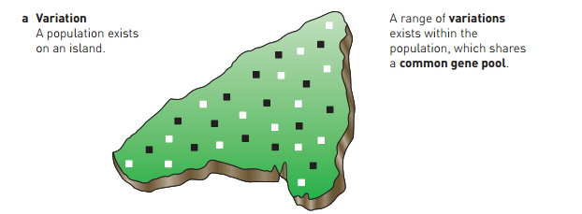
Learning Aim: List and describe the processes involved in speciation

Slide 18
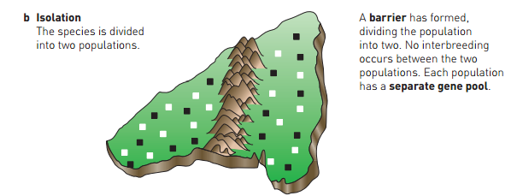
*note – a physical barrier is not always necessary for speciation. If a species is spread over a wide geographic area with different environmental pressures, distance becomes the barrier to reproduction, and selection will take place to suit each environment, even if there is some genetic drift.
Learning Aim: List and describe the processes involved in speciation

Slide 19
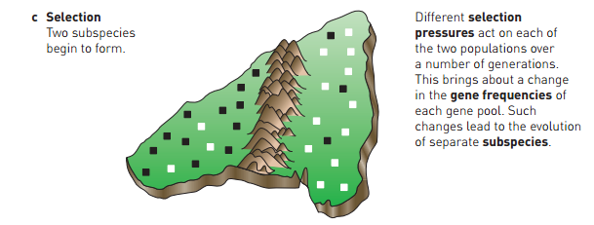
Learning Aim: List and describe the processes involved in speciation

Slide 20
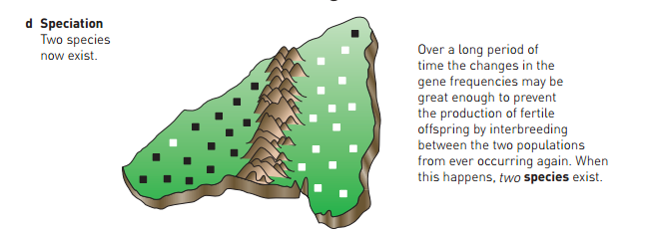
Learning Aim: List and describe the processes involved in speciation

Slide 21
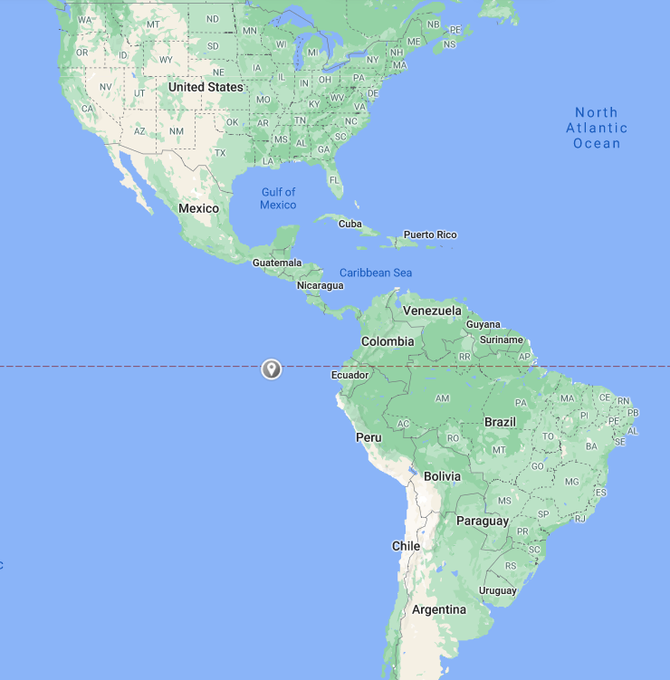
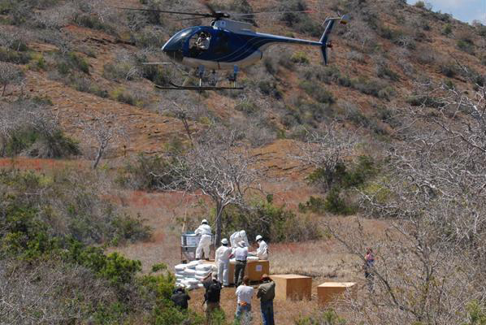
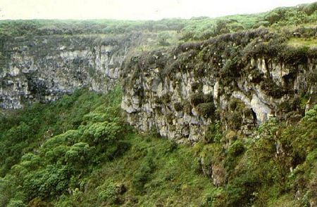
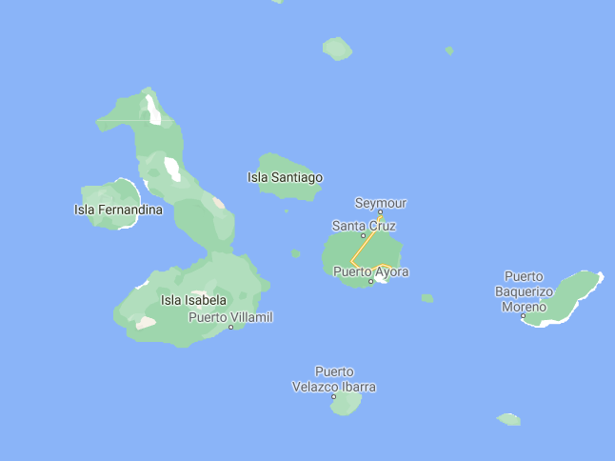
Galapagos Finches and Speciation
Galapagos Islands –
Group of volcanic islands in ocean off South America.
Environment varies widely between islands due to
Age of island – younger islands – less vegetation
Ocean currents and mountains affecting weather
Different environments mean different food sources available
Pinzon Island – arid environment
Humid environment on Santa Cruz Island
Learning Aim: Discuss how speciation occurred for finches on the Galapagos Islands

Slide 22
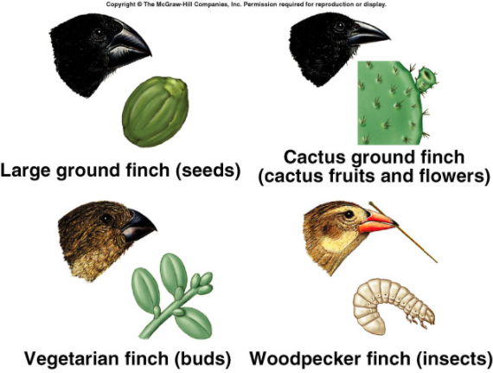
Galapagos Finches and Speciation
In the distant past, finches from the South American mainland arrived in the Galapagos, most likely blown there during storms.
Mainland too far away for gene flow between populations.
Finches colonised different islands, with different climates and food sources.
Limited gene flow between islands
Finch species are adapted (by natural selection) to the food sources on the islands on which they are found.
Learning Aim: Discuss how speciation occurred for finches on the Galapagos Islands

Slide 23
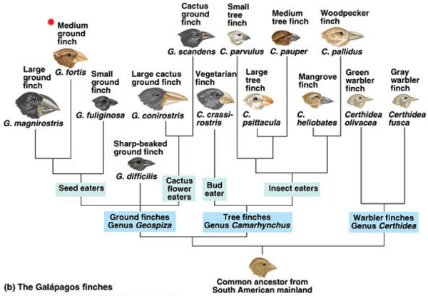
Galapagos Finches and Speciation
Learning Aim: Discuss how speciation occurred for finches on the Galapagos Islands

